Slide 1

Introduction
CHANNEL SHIFT
A D V I S O R
Developed following previous Channel Shift Camps
Based on participant input and lessons learnt from GovMetric
A reporting framework and methodology
A Strawman!
Automated channel interactions
Further thoughts and ideas welcome.

Slide 2
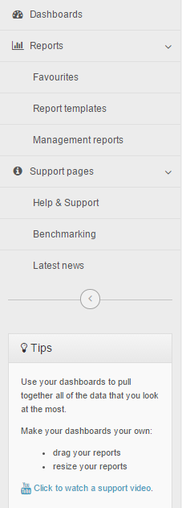
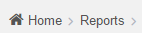
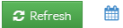
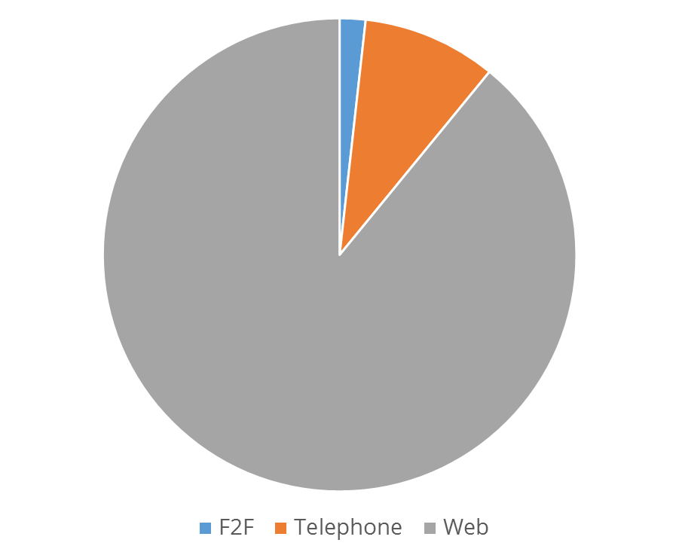
CHANNEL SHIFT
A D V I S O R
Overview
01/10/2014 –
31/10/2014
OVERVIEW
Pie Chart | Bar Chart | Line Graph | Table
Channel
-
√
□ Face to Face
□ Telephone
□ Web
√
√
Service
+
e-Forms
+
Action Type
+
Traffic
+
Devices
+

Slide 3
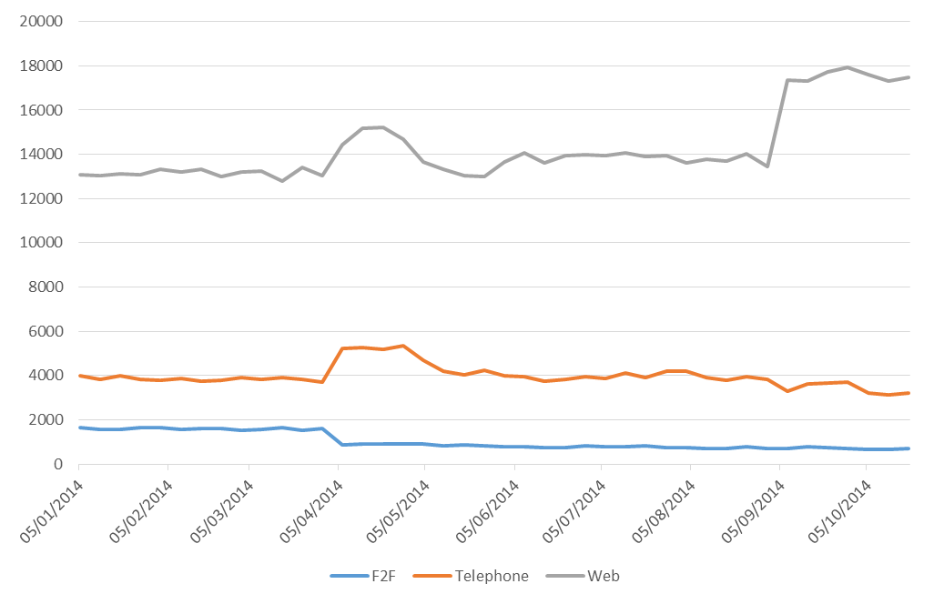
CHANNEL SHIFT
A D V I S O R
Benefits – Housing Benefit
01/01/2014 –
31/10/2014
BENEFITS – HOUSING BENEFIT
Pie Chart | Bar Chart | Line Graph | Table
Channel
-
√
□ Face to Face
□ Telephone
□ Web
√
√
Service
-
□ Adult Services v
□ Benefits –
  □ Appeal
  □ Benefits advice
  □ Benefits fraud
  □ Change of circumstances
  □ Council Tax benefits
  □ Discretionary payment
  □ General enquiry
  □ Housing benefit
□ Children's Services v
□ Council Information v
□ Council Tax v
□ Education v
□ Environmental Services v
□ Housing v
□ Job Vacancies v
□ Libraries & Museums v
□ Licences v
□ Planning & Building Control v
□ Registrations v
□ Roads & Transport v
□ Sports, Leisure & Culture v
□ Streets & Parking v
□ Town Planning v
□ Waste & Recycling v
√

Slide 4
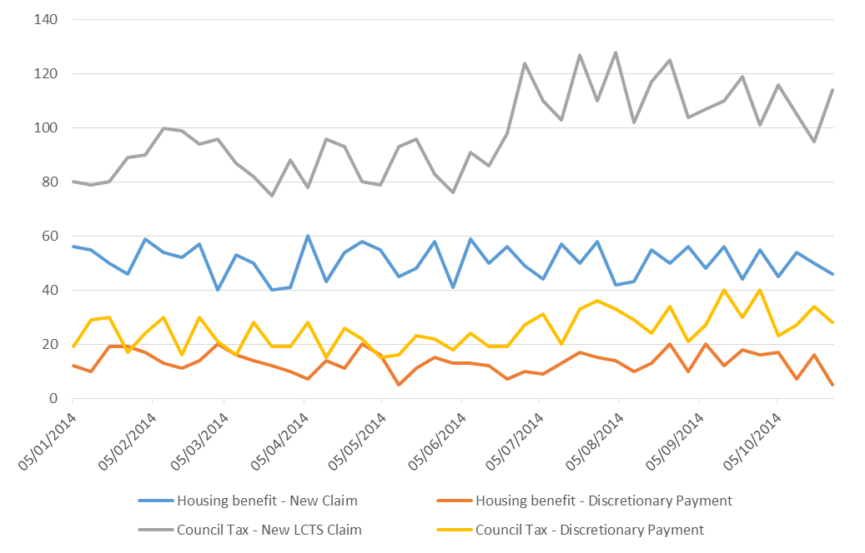
CHANNEL SHIFT
A D V I S O R
e-Forms – Housing / Council Tax Benefit
01/01/2014 –
31/10/2014
E-FORMS - HOUSING / COUNCIL TAX BENEFIT
Pie Chart | Bar Chart | Line Graph | Table
Channel
+
Service
+
e-Forms
-
□ Adult Services v
□ Benefits -
  □ Appeal v
  □ Benefits advice v
  □ Benefits fraud v
  □ Change of circumstances v
  □ Council Tax benefits v
  □ Discretionary payment v
  □ General enquiry v
  □ Housing benefit -
  □ New Claim
  □ Discretionary Payment
□ Children's Services v
□ Council Information v
□ Council Tax -
  □ Business rates v
  □ Change of circumstances v
  □ Council tax enquiries v
  □ Discounts & exemptions -
  □ New LCTS Claim
  □ Discretionary Payment
  □ Change Circumstance
  □ General enquiry v
  □ Payments v
□ Education v
□ Environmental Services v
□ Housing v
□ Job Vacancies v
□ Libraries & Museums v
□ Licences v
□ Planning & Building Control v
□ Registrations v
□ Roads & Transport v
□ Sports, Leisure & Culture v
□ Streets & Parking v
□ Town Planning v
□ Waste & Recycling v
□ Other v
√
√
√
√

Slide 5
CHANNEL SHIFT
A D V I S O R
e-Forms – Housing / Council Tax Benefit
01/10/2014 –
31/10/2014
E-FORMS - HOUSING / COUNCIL TAX BENEFIT
Pie Chart | Bar Chart | Line Graph | Table
Channel
+
Service
+
e-Forms
-
□ Adult Services v
□ Benefits -
  □ Appeal v
  □ Benefits advice v
  □ Benefits fraud v
  □ Change of circumstances v
  □ Council Tax benefits v
  □ Discretionary payment v
  □ General enquiry v
  □ Housing benefit -
  □ New Claim
  □ Discretionary Payment
□ Children's Services v
□ Council Information v
□ Council Tax v
□ Education v
□ Environmental Services v
□ Housing v
□ Job Vacancies v
□ Libraries & Museums v
□ Licences v
□ Planning & Building Control v
□ Registrations v
□ Roads & Transport v
□ Sports, Leisure & Culture v
□ Streets & Parking v
□ Town Planning v
□ Waste & Recycling v
□ Other v
 | 05/10/2014 | 12/10/2014 | 19/10/2014 | 26/10/2014
Housing benefit - New Claim | 45 | 54 | 50 | 46
Housing benefit - Discretionary Payment | 17 | 7 | 16 | 5
Council Tax - New LCTS Claim | 116 | 105 | 95 | 114
Council Tax - Discretionary Payment | 23 | 27 | 34 | 28
√

Slide 6
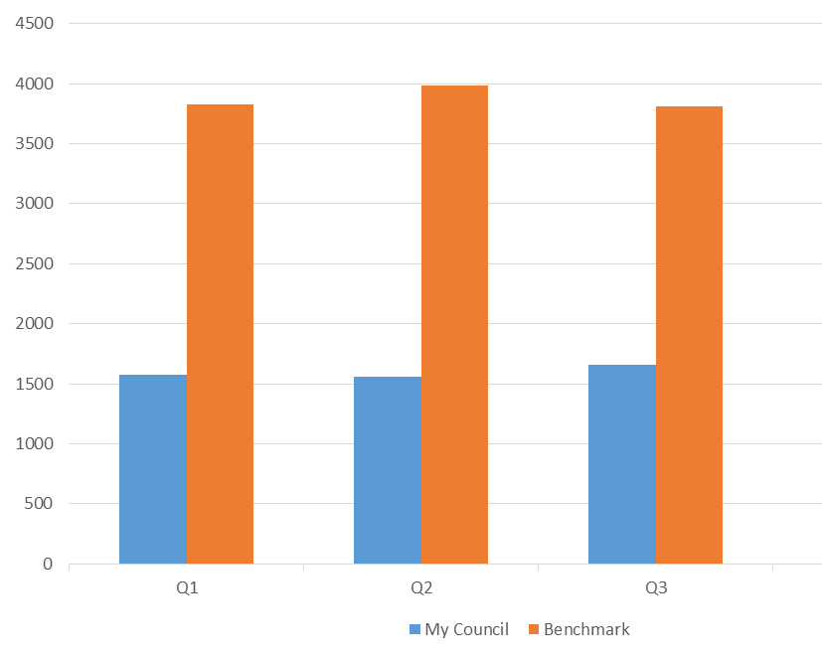
CHANNEL SHIFT
A D V I S O R
Benchmarking – Housing Benefit
01/01/2014 –
31/10/2014
BENCHMARKING – HOUSING BENEFIT
Pie Chart | Bar Chart | Line Graph | Table
Channel
-
□ Face to Face
□ Telephone
□ Web
√
Service
-
□ Adult Services v
□ Benefits –
  □ Appeal
  □ Benefits advice
  □ Benefits fraud
  □ Change of circumstances
  □ Council Tax benefits
  □ Discretionary payment
  □ General enquiry
  □ Housing benefit
□ Children's Services v
□ Council Information v
□ Council Tax v
□ Education v
□ Environmental Services v
□ Housing v
□ Job Vacancies v
□ Libraries & Museums v
□ Licences v
□ Planning & Building Control v
□ Registrations v
□ Roads & Transport v
□ Sports, Leisure & Culture v
□ Streets & Parking v
□ Town Planning v
□ Waste & Recycling v
√

Slide 7
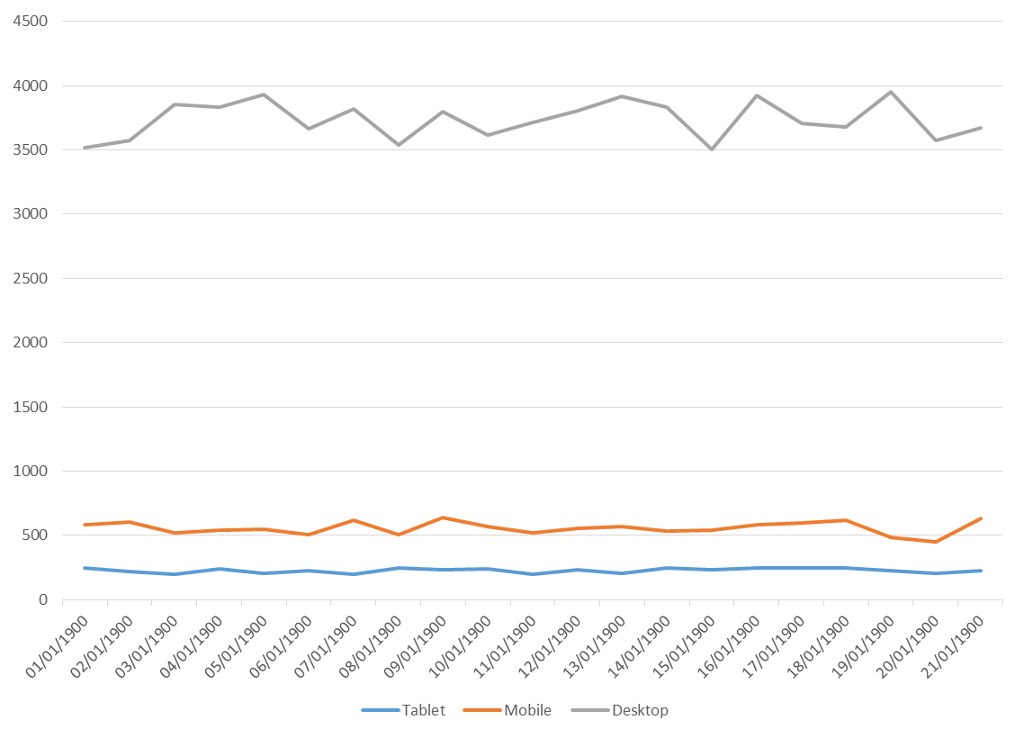
CHANNEL SHIFT
A D V I S O R
Traffic Analysis
01/01/2014 –
31/12/2014
TRAFFIC ANALYSIS
Pie Chart | Bar Chart | Line Graph | Table
Channel
-
□ Face to Face
□ Telephone
□ Web
√
Service
+
e-Forms
+
Action Type
+
Traffic
+
√
□ Windows
□ Android
□ Apple
Devices
+
√
□ Desktop
□ Tablet
□ Mobile
□ Interactive TV
√
√

Slide 8
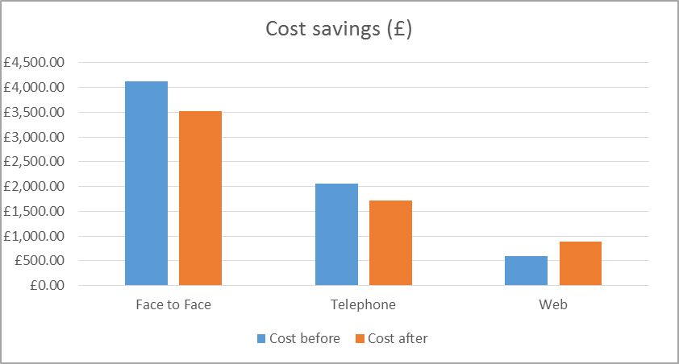
CHANNEL SHIFT
A D V I S O R
Channel Shift Calculator
01/10/2014 –
02/10/2014
CHANNEL SHIFT CALCULATOR
Pie Chart | Bar Chart | Line Graph | Table
Data
+
□ Adult Services v
□ Benefits -
Face to Face (£) F2F to Tel (%)
Telephone F2F to Web (%)
Web Tel to Web (%)
□ Council Information v
□ Council Tax v
□ Education v
□ Environmental Services v
□ Housing v
□ Job Vacancies v
□ Libraries & Museums v
□ Licences v
□ Planning & Building Control v
□ Registrations v
□ Roads & Transport v
□ Sports, Leisure & Culture v
□ Streets & Parking v
□ Town Planning v
□ Waste & Recycling v
□ Other v
√
 | Cost before | Cost after | Saving
Face to Face | £4,120.00 | £3,522.60 | £597.40
Telephone | £2,050.00 | £1,722.00 | £328.00
Web | £600.00 | £879.06 | -£279.06
Total cost saving |  |  | £646.34
£8.24
10%
£2.05
5%
£0.12
20%
√

Slide 9
CHANNEL SHIFT
A D V I S O R
Channel Shift Calculator
01/10/2014 –
02/10/2014
CHANNEL SHIFT CALCULATOR
Pie Chart | Bar Chart | Line Graph | Table
Data
+
□ Adult Services v
□ Benefits -
Face to Face (£) F2F to Tel (%)
Telephone F2F to Web (%)
Web Tel to Web (%)
□ Council Information v
□ Council Tax -
Face to Face (£) F2F to Tel (%)
Telephone F2F to Web (%)
Web Tel to Web (%)
□ Education v
□ Environmental Services v
□ Housing v
□ Job Vacancies v
□ Libraries & Museums v
□ Licences v
□ Planning & Building Control v
□ Registrations v
□ Roads & Transport v
□ Sports, Leisure & Culture v
□ Streets & Parking v
□ Town Planning v
□ Waste & Recycling v
□ Other v
√
 | Cost before | Cost after | Saving
Face to Face | £10,168.16 | £8,693.78 | £1,474.38
Telephone | £4,721.15 | £3,979.30 | £741.85
Web | £1,225.80 | £1,806.98 | -£581.18
Total cost saving |  |  | £1,635.06
£8.24
10%
£2.05
5%
£0.12
20%
√
£6.50
10%
£1.75
10%
£0.12
25%

Slide 10
Benefits
CHANNEL SHIFT
A D V I S O R

